Slide 1


End to End Automated Regression Testing with Playwright
https://github.com/BMayhew/playwright-demo
@butchmayhew
Notes:
End to End = Dom to Database!!!!
Regression testing == to give us confidence in our releases.

Slide 2

The 'New Tool On The Block' Playwright!
https://github.com/BMayhew/playwright-demo
@butchmayhew
Notes:
End to End = Dom to Database!!!!
Regression testing == to give us confidence in our releases.

Slide 3

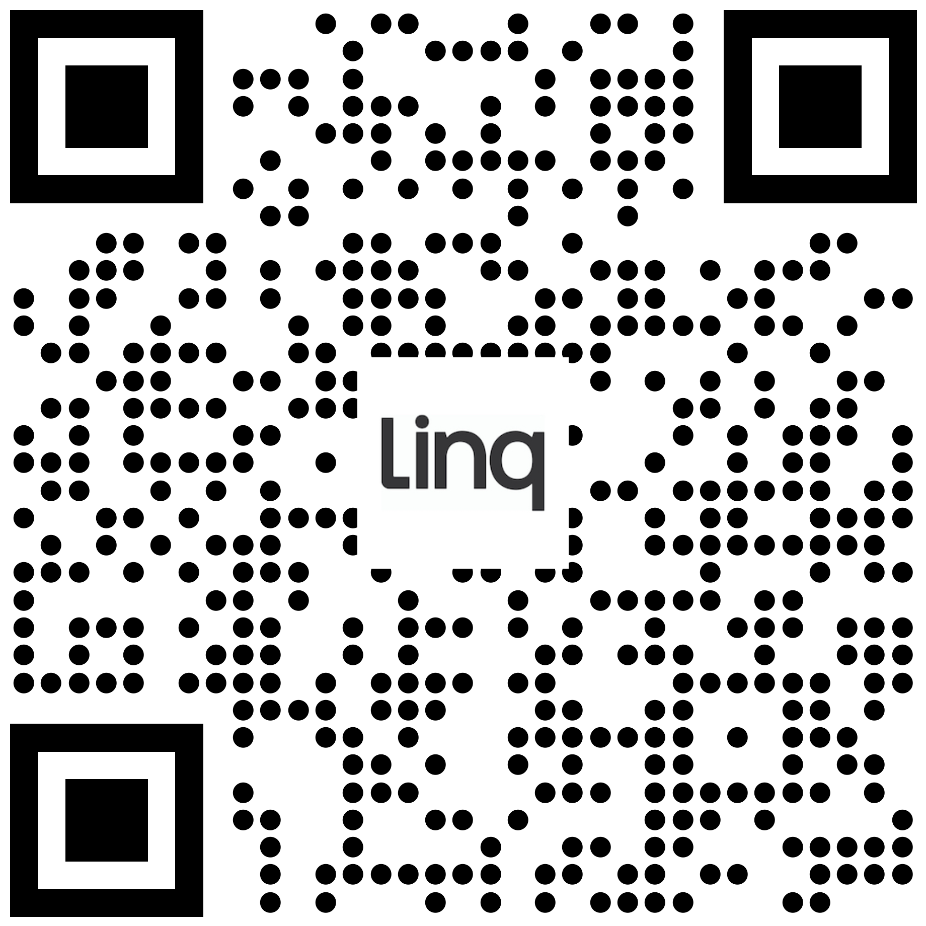
HOWDY 👋 I’m
Butch Mayhew
https://github.com/BMayhew/playwright-demo
@butchmayhew
Notes:
End to End = Dom to Database!!!!
Regression testing == to give us confidence in our releases.

Slide 4

Automate All the Things
https://github.com/BMayhew/playwright-demo
@butchmayhew
Notes:
End to End = Dom to Database!!!!
Regression testing == to give us confidence in our releases.

Slide 5
Automate All the RIGHT Things
At the right levels:
Unit/component tests
API regression tests
UI regression tests
Smoke tests
Performance tests
Security tests
https://github.com/BMayhew/playwright-demo
@butchmayhew
Notes:
End to End = Dom to Database!!!!
Regression testing == to give us confidence in our releases.

Slide 6
Automate All the RIGHT Things
At the right levels:
Unit/component tests
API regression tests (Http to DB)
UI regression tests (Dom to DB)
*Smoke tests
Performance tests
Security tests
https://github.com/BMayhew/playwright-demo
@butchmayhew
Notes:
End to End = Dom to Database!!!!
Regression testing == to give us confidence in our releases.

Slide 7
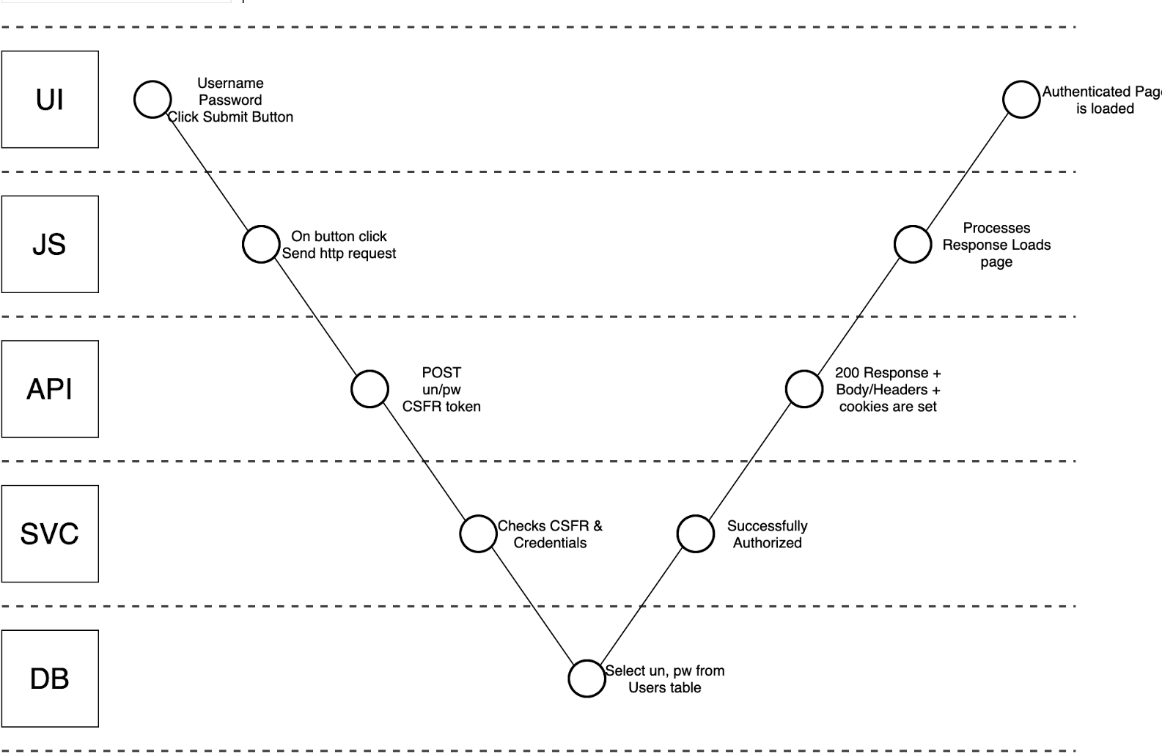
DOM to Database: Visual Task Analysis
https://github.com/BMayhew/playwright-demo
@butchmayhew
Notes:
End to End = Dom to Database!!!!
Regression testing == to give us confidence in our releases.

Slide 8
Automate All the RIGHT Things
At the right levels:
Unit/component tests
API regression tests
UI regression tests
*Smoke tests
Performance tests
Security tests
https://github.com/BMayhew/playwright-demo
@butchmayhew
Notes:
End to End = Dom to Database!!!!
Regression testing == to give us confidence in our releases.

Slide 9
Automate All the RIGHT Things
At the right levels:
Unit/component tests
API regression tests
UI regression tests
*Smoke tests
Performance tests
Security tests
You can’t automate away exploratory testing
https://github.com/BMayhew/playwright-demo
@butchmayhew
Notes:
End to End = Dom to Database!!!!
Regression testing == to give us confidence in our releases.

Slide 10
Automate All the RIGHT Things
At the right levels:
Unit/component tests
API regression tests
UI regression tests
*Smoke tests
Performance tests
Security tests
You can’t automate away exploratory testing
BUT you can automate boring checks (test cases)
https://github.com/BMayhew/playwright-demo
@butchmayhew
Notes:
End to End = Dom to Database!!!!
Regression testing == to give us confidence in our releases.

Slide 11
Automate All the RIGHT Things
At the right levels:
Unit/component tests
API regression tests
UI regression tests
*Smoke tests
Performance tests
Security tests
You can’t automate away exploratory testing
BUT you can automate boring checks (test cases)
Big fan of using automation in testing – frees me up to apply critical thinking to the system/changes
https://github.com/BMayhew/playwright-demo
@butchmayhew
Notes:
End to End = Dom to Database!!!!
Regression testing == to give us confidence in our releases.

Slide 12

Agenda
01 What is Playwright?
Overview of Playwright
02 Tilled’s CI/CD Pipeline
Where we leverage Playwright in CI
Overview of GitHub actions file
03 IMO: Top 6 Features
Videos, Retries, Reporters, Workers, VS Code Extension, Developer Docs
04 Overview of a Test
UI - Login spec API – Delete Account
Best Practices
https://github.com/BMayhew/playwright-demo
@butchmayhew
Notes:
End to End = Dom to Database!!!!
Regression testing == to give us confidence in our releases.

Slide 13

What is Playwright?
Playwright is an opensource tool built by Microsoft that enables reliable end-to-end UI and API testing for modern web apps.
https://github.com/BMayhew/playwright-demo
@butchmayhew
Notes:
End to End = Dom to Database!!!!
Regression testing == to give us confidence in our releases.

Slide 14
What is Playwright?
50K ⭐️’s on GitHub
~Monthly Release Cycle
TypeScript, JavaScript, Python, .NET, Java (Ruby/Go Community)
Closer to Selenium WebDriver than Cypress
An out-of-process automation driver that is not limited by the scope of in-page JavaScript execution.
Built-in Test Runner (TS/JS only)
https://github.com/BMayhew/playwright-demo
@butchmayhew
Notes:
End to End = Dom to Database!!!!
Regression testing == to give us confidence in our releases.

Slide 15

Tilled’s CI/CD Pipeline

Slide 16

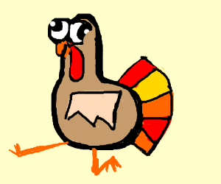
https://github.com/BMayhew/playwright-demo
@butchmayhew
Notes:
End to End = Dom to Database!!!!
Regression testing == to give us confidence in our releases.

Slide 17
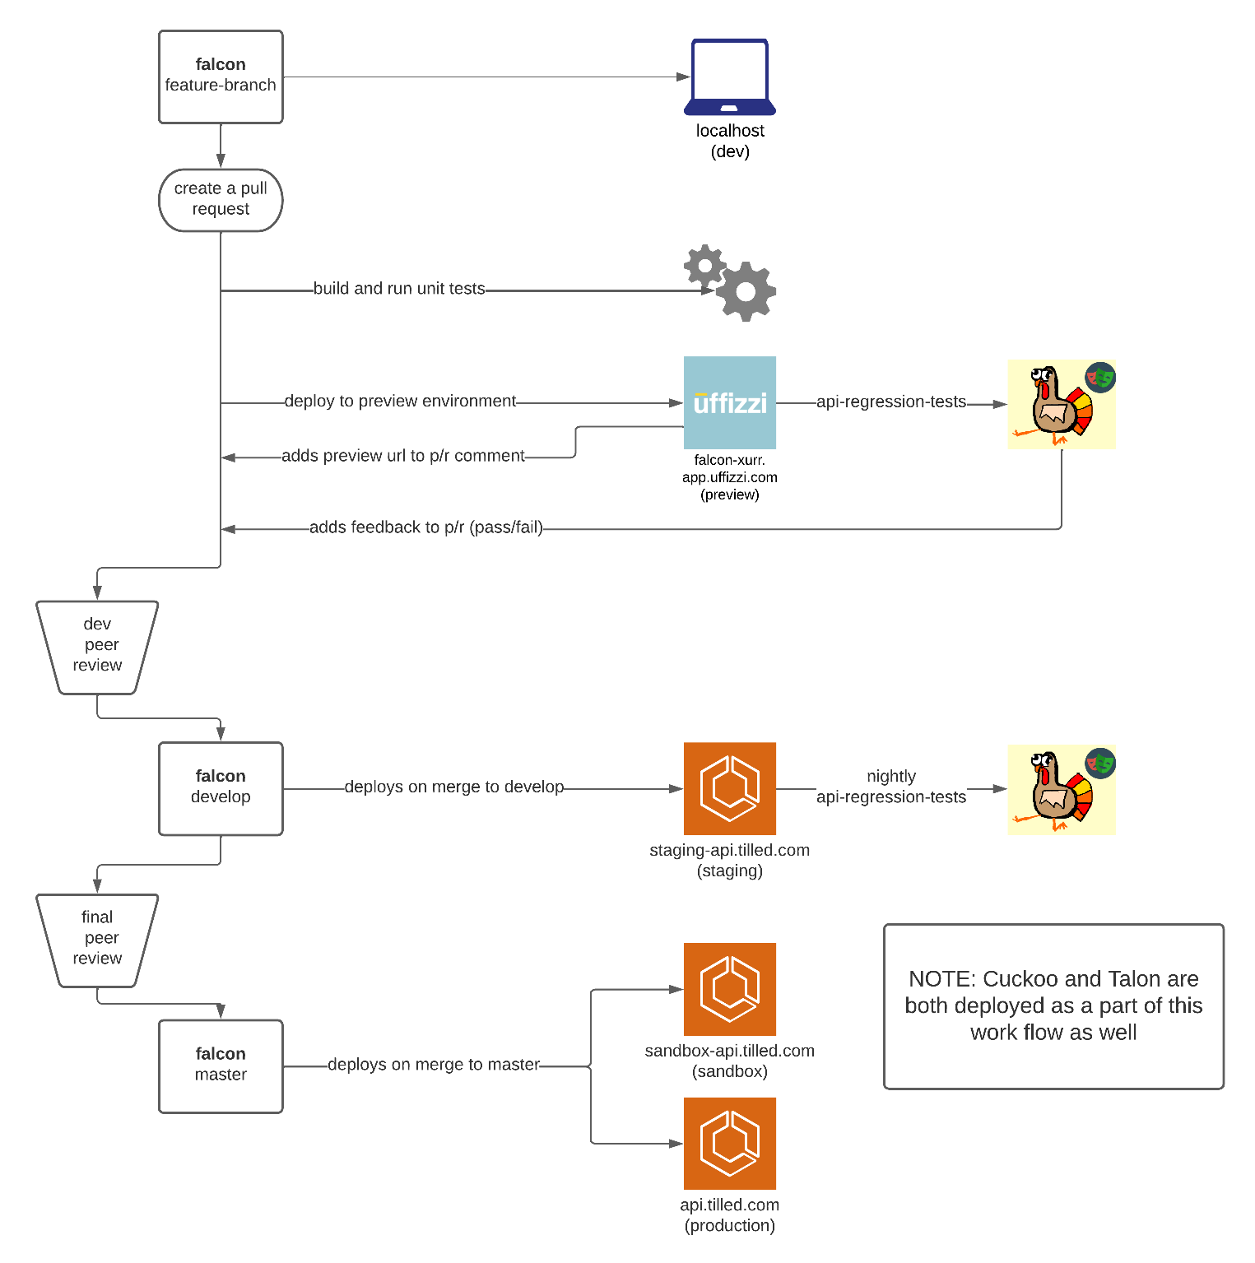


API Service
falcon
https://github.com/BMayhew/playwright-demo
@butchmayhew
Notes:
End to End = Dom to Database!!!!
Regression testing == to give us confidence in our releases.

Slide 18
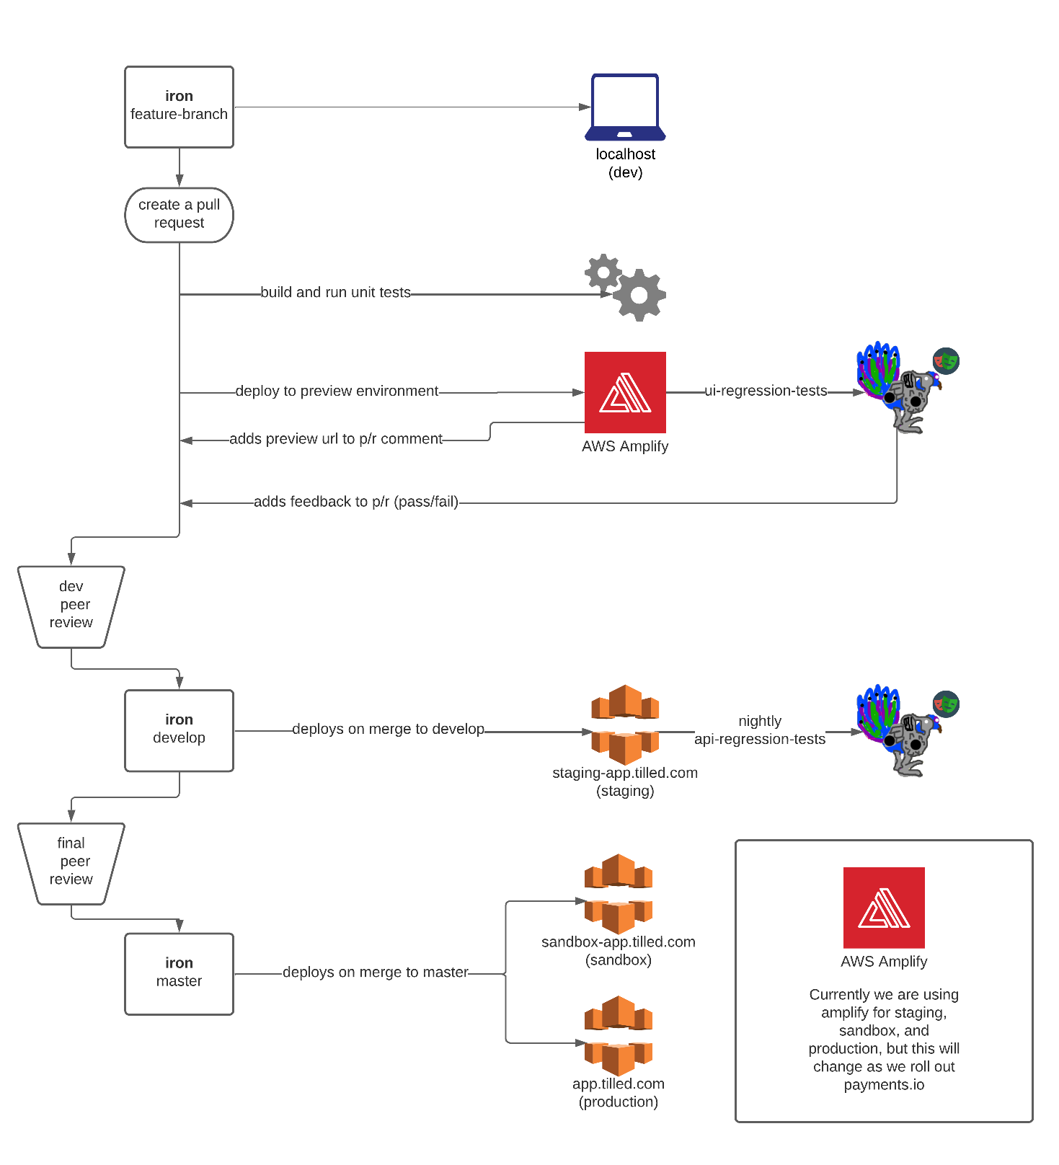
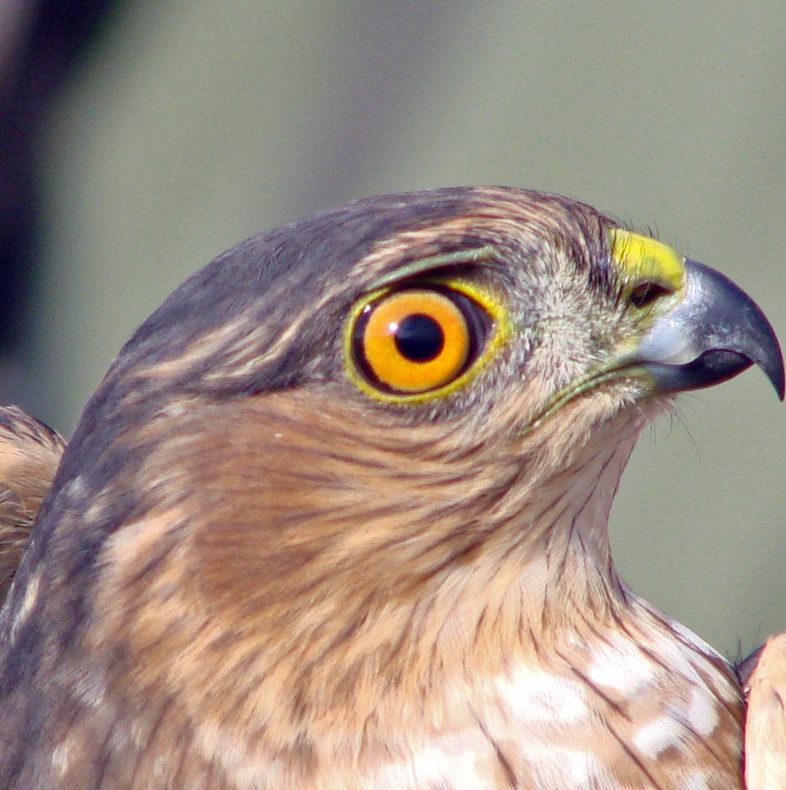
Front End
hawkeye
https://github.com/BMayhew/playwright-demo
@butchmayhew
Notes:
End to End = Dom to Database!!!!
Regression testing == to give us confidence in our releases.

Slide 19
Exploratory Testing Happens….
https://github.com/BMayhew/playwright-demo
@butchmayhew
Notes:
End to End = Dom to Database!!!!
Regression testing == to give us confidence in our releases.

Slide 20
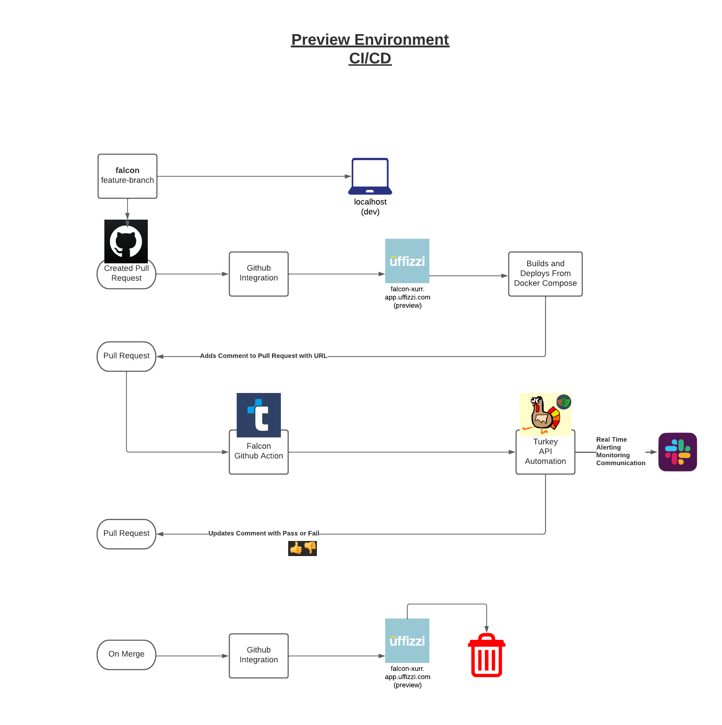
Birdwatching
https://github.com/BMayhew/playwright-demo
@butchmayhew
Notes:
End to End = Dom to Database!!!!
Regression testing == to give us confidence in our releases.

Slide 21
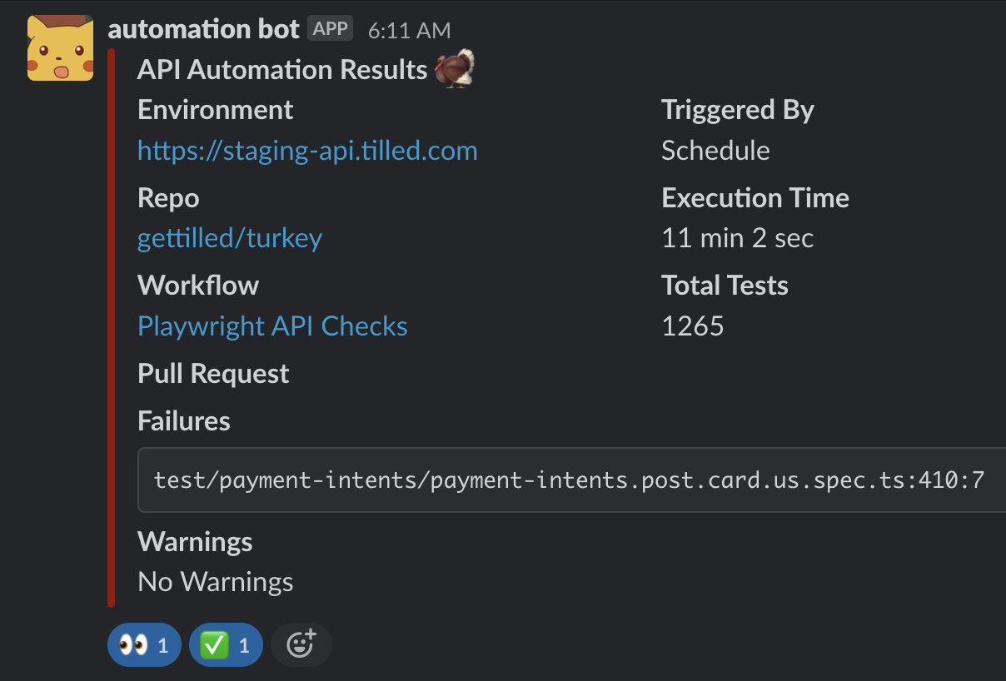
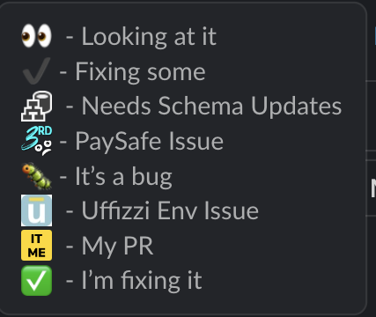
Birdwatching
https://github.com/BMayhew/playwright-demo
@butchmayhew
Notes:
End to End = Dom to Database!!!!
Regression testing == to give us confidence in our releases.

Slide 22
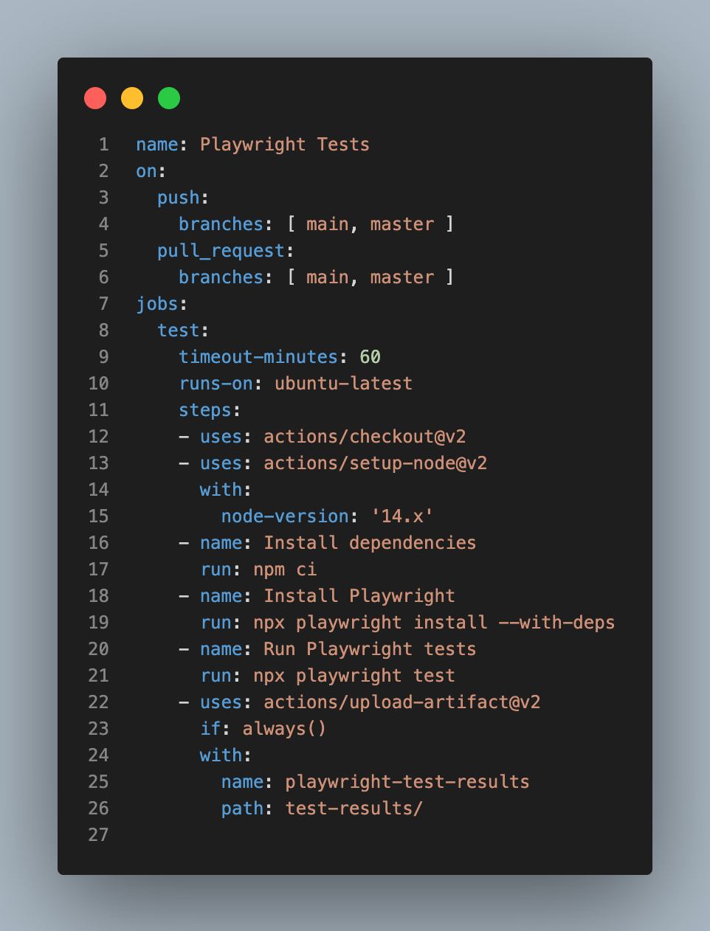
GitHub Actions
yml File
https://github.com/BMayhew/playwright-demo
@butchmayhew
Notes:
End to End = Dom to Database!!!!
Regression testing == to give us confidence in our releases.

Slide 23
IMO Top Playwright Features as of Today
Reporters
Videos
Retries
Workers (Parallelization)
VSCode Extension
UI mode
Developer Docs
Ability to Run API/UI Regression
Tests In the Same Framework
https://github.com/BMayhew/playwright-demo
@butchmayhew
Notes:
End to End = Dom to Database!!!!
Regression testing == to give us confidence in our releases.

Slide 24
Overview of a Spec (Playwright Test Runner)
Login – UI
Register UI
Delete User Account - API
https://github.com/BMayhew/playwright-demo
@butchmayhew
Notes:
End to End = Dom to Database!!!!
Regression testing == to give us confidence in our releases.

Slide 25
DEMO
https://github.com/BMayhew/playwright-demo
@butchmayhew
Notes:
End to End = Dom to Database!!!!
Regression testing == to give us confidence in our releases.

Slide 26

https://github.com/BMayhew/playwright-demo
@butchmayhew
Notes:
End to End = Dom to Database!!!!
Regression testing == to give us confidence in our releases.

Slide 27
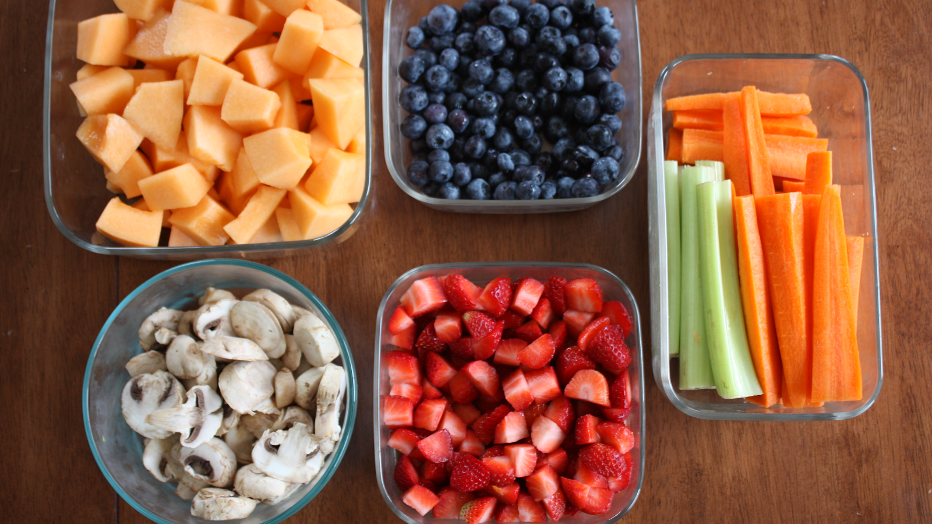
https://github.com/BMayhew/playwright-demo
@butchmayhew
Notes:
End to End = Dom to Database!!!!
Regression testing == to give us confidence in our releases.

Slide 28
DEMO
https://github.com/BMayhew/playwright-demo
@butchmayhew
Notes:
End to End = Dom to Database!!!!
Regression testing == to give us confidence in our releases.

Slide 29
Automated Testing Great Practices
Write independent automated tests – remove as many dependencies as possible, tests shouldn’t share data between themselves
Setup data/state via API calls
Utilize static data when absolutely necessary (make sure there is an easy way to create static data against any new environments)
Leave state the same way you found it (the framework handles this for us)
Create re-usable methods/functions (page object model)
If #1 is true, we can run all tests in parallel 🏃💨
Goal of suite is catching regressions
https://github.com/BMayhew/playwright-demo
@butchmayhew
Notes:
End to End = Dom to Database!!!!
Regression testing == to give us confidence in our releases.

Slide 30
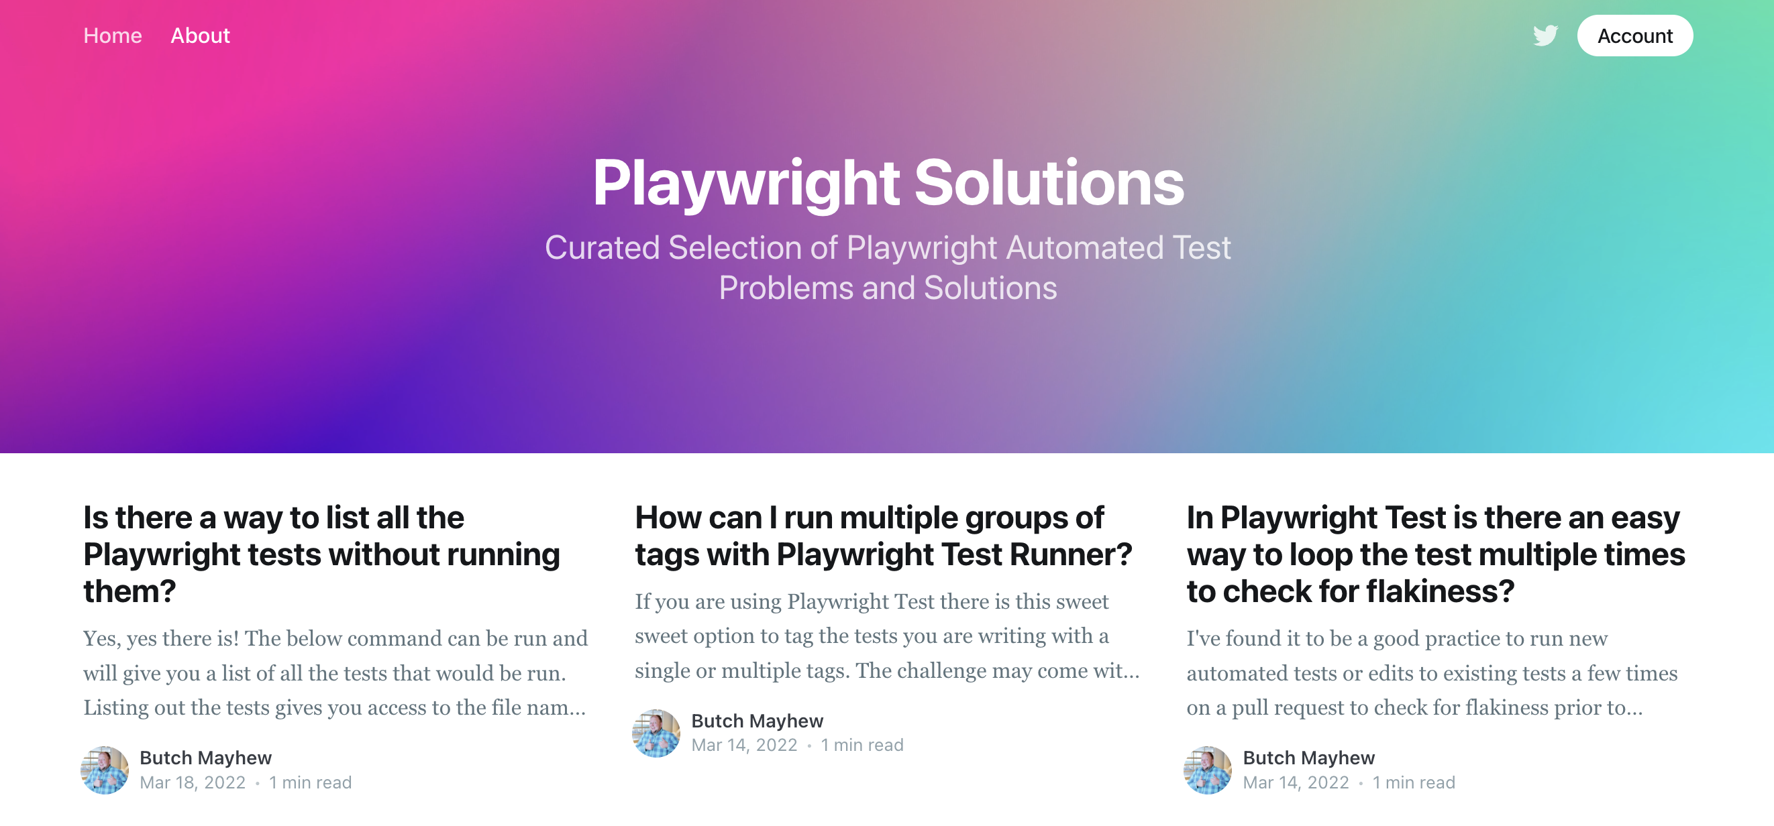
https://playwrightsolutions.com
https://github.com/BMayhew/playwright-demo
@butchmayhew
Notes:
End to End = Dom to Database!!!!
Regression testing == to give us confidence in our releases.

Slide 31
Connect
With Me!
https://github.com/BMayhew/playwright-demo
@butchmayhew
Notes:
End to End = Dom to Database!!!!
Regression testing == to give us confidence in our releases.

Slide 32

https://github.com/BMayhew/playwright-demo
@butchmayhew
Notes:
End to End = Dom to Database!!!!
Regression testing == to give us confidence in our releases.

Slide 33
Playwright Workshop
https://github.com/BMayhew/playwright-demo
@butchmayhew
Notes:
End to End = Dom to Database!!!!
Regression testing == to give us confidence in our releases.

